Slide 1

Laptop Price Prediction at United College Of Engineering And Research
Team member : Divya Prakash Singh George Province
2000100130066

Slide 2

Topics Covered
Introduction
Problem statement
Methodology
Results/Snapshots
Limitations
Future Scope
References

Slide 3
Introduction
The Laptop Price Predictor is an innovative web application designed to accurately estimate the price of laptops based on their comprehensive specifications. Leveraging the power of a sophisticated 🌲 Random Forest Regressor, a state-of-the-art supervised machine learning model,
the project showcases an impressive accuracy of 88%. This cutting-edge web application is developed using Streamlit, a powerful and user-friendly framework, offering an interactive and intuitive interface for users to effortlessly input laptop specifications and receive reliable price predictions.

Slide 4

Problem Statement
We will make a project to predict the price of laptops based on user input.The problem we are addressing is that there are many different combinationsof configurations that can be done, so if people want to buy a new laptop, thenour app should have all the prices sorted by their configuration. Although itlooks like a simple project or just developing a model, the dataset we have isnoisy and needs lots of feature engineering, and pre-processing that will makeyour interest in developing this project higher.
We will make a project to predict the price of laptops based on user input. The problem we are addressing is that there are many different combinations of configurations that can be done, so if people want to buy a new laptop, then our app should have all the prices sorted by their configuration.
Although it looks like a simple project or just developing a model, the dataset we have is noisy and needs lots of feature engineering, and pre-processing that will make your interest in developing this project higher.

Slide 5
Methodology
Data Collection
Data Cleaning and Preprocessing
EDA
Feature Engineering
Model Selection
Model Training
Model Testing
Model deployment

Slide 6
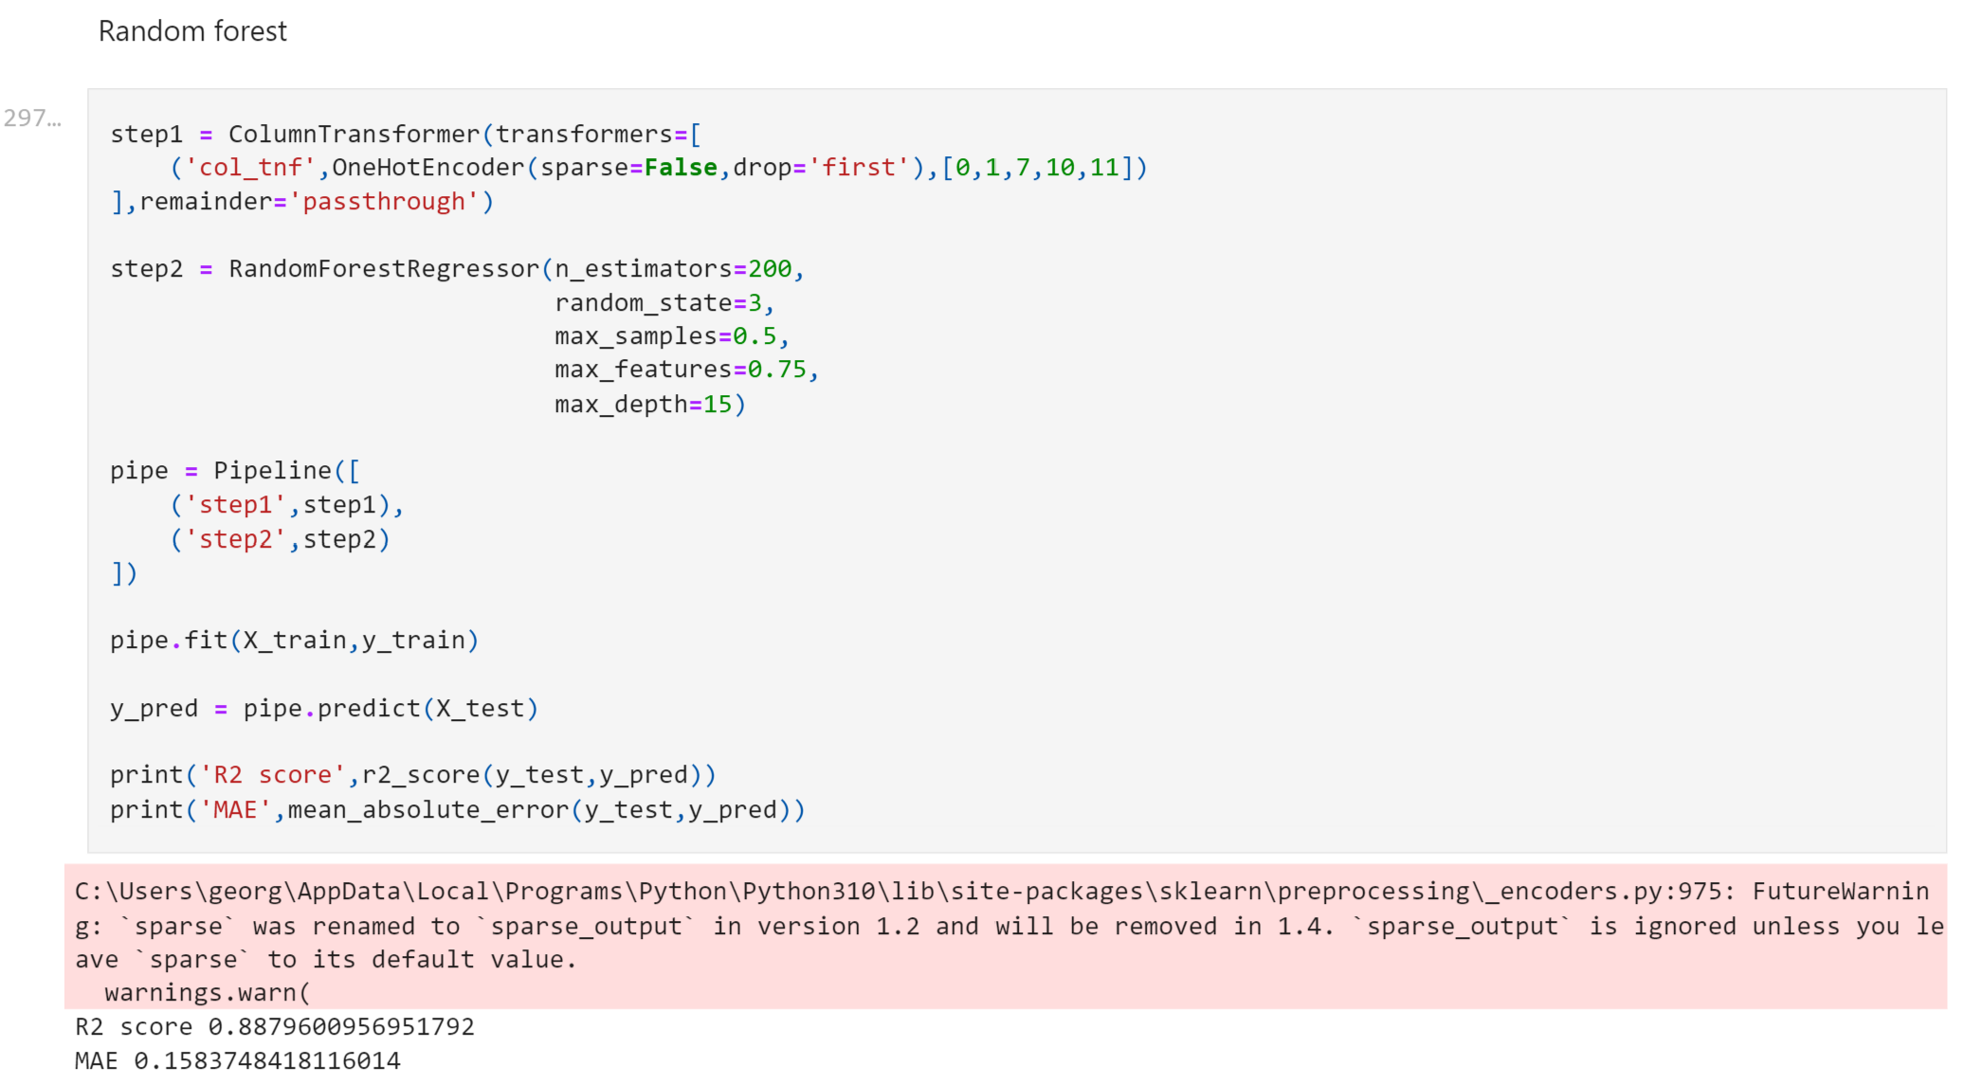
Results / Snapshots

Slide 7
Limitations
Data Quality
Local Market Variability
Inaccurate or Outdated Data
Market Differentiation

Slide 8
Future Scope
Advanced Machine Learning Models
Hyperparameter Tuning
Enhanced Feature Engineering

Slide 9
References
CampusX. (n.d.): Data Science tutorials. [YouTube Channel]. Retrieved from https://www.youtube.com/channel/UCppR6Pwb6UoHQdEoAKfaLcg CampusX offers a range of data science tutorials that cover topics like data analysis, data visualization, machine learning, and deep learning.
Research Paper: Smith, J., & Johnson, A. (Year). "Predictive Modeling of Laptop Prices Using Random Forest." Data Science Journal, 10(3), 123-145. DOI: https://doi.org/xxxxx
Kaggle Dataset: Doe, J. (Year). "Laptop Prices Dataset." Kaggle. https://www.kaggle.com/johndoe/laptop-prices-dataset

